Slide 1
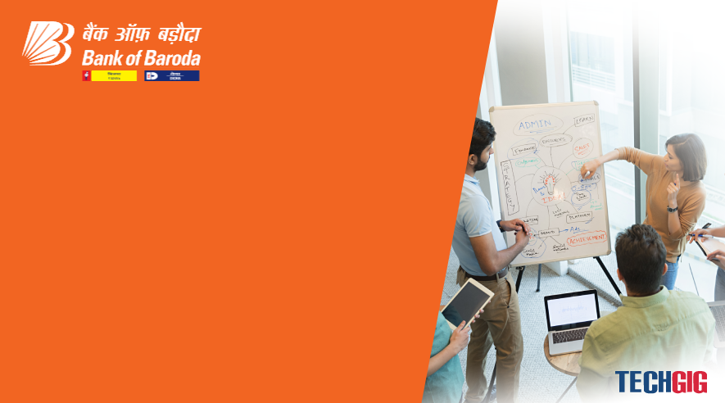
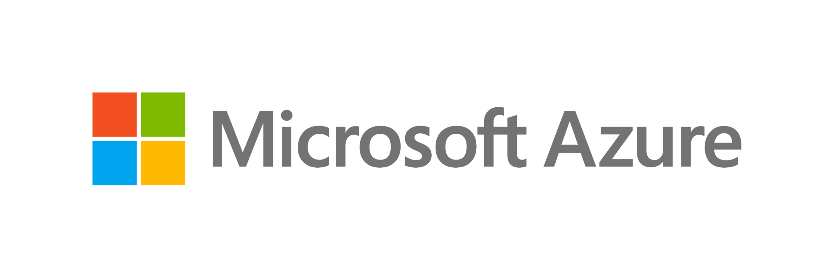
Bank of Baroda Hackathon - 2022
Technology Partner
Your Team Name : Zeroday
Your team bio : VCET STUDENTS
Date :14.08.2022

Slide 2
Problem Statement?
Why did you decide to solve this Problem statement?
We choose the Alternate Authentication problem to implement the new user friendly environment . This problem is mostly important for the security field to improve the future technology.
It also help the users easy to access a secure field of authentication. This Authentication is mostly used in banks to improve their security feature , it help the banks to verify the users in online .

Slide 3
User Segment & Pain Points
Which user /advertiser segment would be early adopter of your product & why?
The most of the teen ages and elders adapt this producut .The majorty of the peoples are using the Online Authentication to reduce their time .
Our new product help the online Authentication to improve the security features , more user friendly and reduce the time conception . Our project is mostly help the people how using banking Authentications .

Slide 4
Pre-Requisite
What are the alternatives/competitive products for the problem you are solving?
To solve a problem we are using face Authentication and voice Authentication to make the Authentication more user friendly and efficient .
The basic PIN and OTP Authentication are easily hack or guess by the hackers. But our real time authentications are very difficult to crack by hackers . We also adding the emergency protocol technology to help the users .

Slide 5
Azure tools or resources
Azure tools or resources which are likely to be used by you for the prototype, if your idea gets selected → We Build our product using Python , Flutter , SQl and JavaScript. → We deploy our codes in Github to easy to access at any time. → It also support the end-to-end protocol and we add a high level encryption . → Our product can also support in future AI technology’s.

Slide 6
Any Supporting Functional Documents
Present your solution, talk about methodology, architecture & scalability
We using the Face Authentication and Voice Authentication technology in our product. The face Authentication is run by face morphing technology and live environment scanning .In other hand the voice Authentications are run by the frequency checker and word compassion technology .
We add the Face Authentication as First step of verification and Voice Authentication as second step . We also add a new feature in Voice Authentication “LOCKDOWN MODE”. If the user in emergency situation it will automatically shutdown the app and sent notification to the bank.

Slide 7
Key Differentiators & Adoption Plan
How is your solution better than alternatives and how do you plan to build adoption?
The basic PIN and OTP Authentication are easily hack or guess by the hackers. But our real time authentications are very difficult to crack by hackers . Our product is easy to adopt by the users we using the fast and secure protocol to improve our product .
This products are easily accepted by the smartphone users because it secure and others cannot have idea what they are doing.

Slide 8
GitHub Repository Link & supporting diagrams, screenshots, if any
How far it can go?
Our product is base on the future technology because most of the tech giants are improving their “AI” technology . So our product is easy to adopt in new future technology.
GitHub : https://github.com/Thens18/Zeroday.git

Slide 9
Thank You
Team members name : Thennavan , Shafiq Ahamed , Sudharsan , Saravanan

